Slide 1

Start-up recommendation: Province of Rome, Italy
(Capstone project for IBM Data Science Professional Certification)

Slide 2
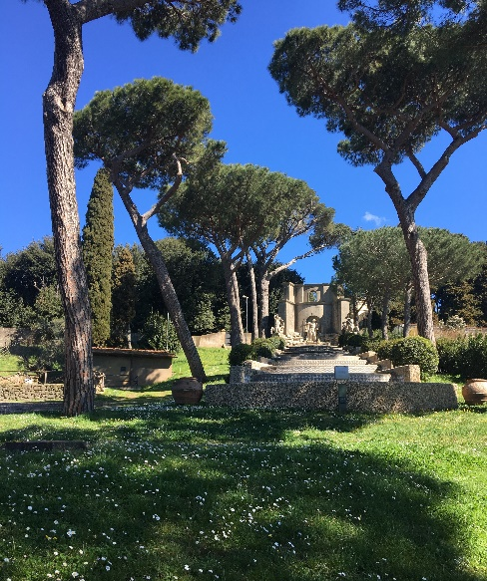
Introduction
Rome has a population of 2 856 133.
The province of Rome has 1 486 079 residents distributed in about 121 towns around Rome (radius of 50km).
Office space and taxes in Rome itself is high
Capital needed for start-up would be prohibitive for a small business.
We therefor explore the possibility of opening a business in the province of Rome.

Slide 3
Business Question
What would be the best business to start in the province of Rome (outside the capital) and which towns would be most appropriate?

Slide 4

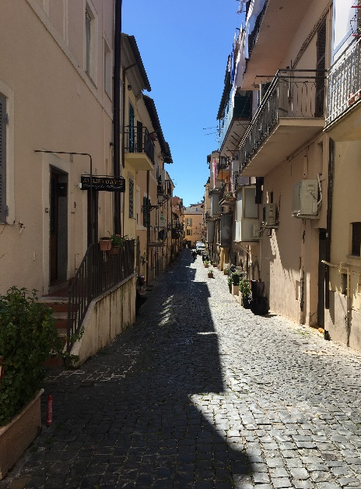
Approach
Find data for all the towns in the province of Rome
Analyse all the towns for the following aspects:
Population
Venues already recorded
find all the data on Foursquare for those towns
Use K-means to cluster the business venues
Select the towns with the highest population and propose as business the types that are the least common in those towns.

Slide 5
Data Used
Get the geospatial co-ordinates for the towns surrounding Rome:
Publicly available at: http://www.dossier.net/utilities/coordinate-geografiche/provincia-roma.htm’
Get the demographical of each town:
Publicly available at: https://www.tuttitalia.it/lazio/provincia-di-roma/36-comuni/popolazione/'
Get the Foursquare data for all towns in the province
Explore the venues in the Rome Province

Slide 6
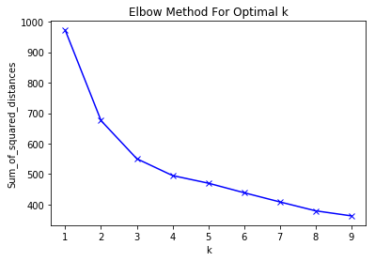
Method Part 1
Combined the data from the 2 websites in a one dataframe.
Fetched the venue data from Foursquare in a radius of 50km around Rome for each town (except Rome itself ) in the combined dataframe. This yielded 559 venues and 118 different categories of venue.
I then prepared the data to be used in a kmeans algorithm by one-hot encoding the data retrieved from Foursquare.( Town/Neighborhood and 118 categories)
I applied various values of k to the kmeans algorithm to decide which would be the best. This method did not produce a very clear result but I decided to use a k of 4

Slide 7
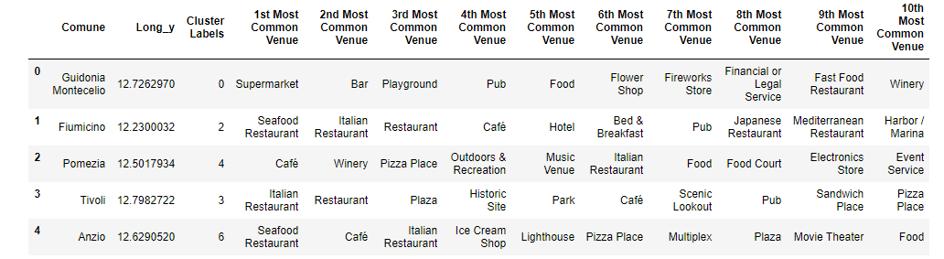
Method part 2

Slide 8
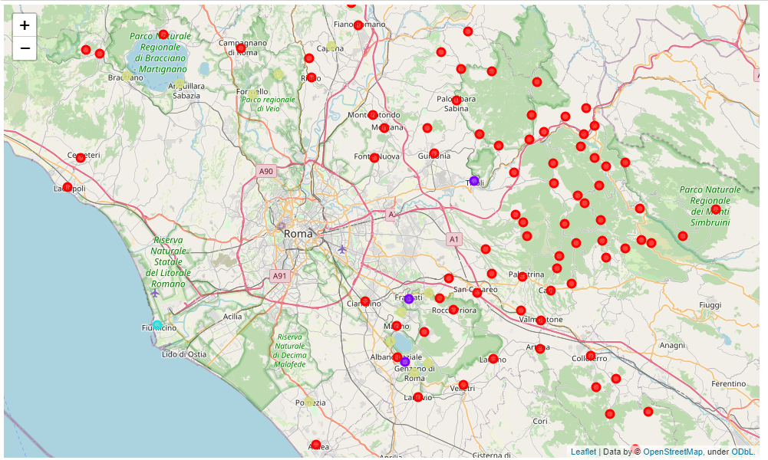
Cluster map

Slide 9
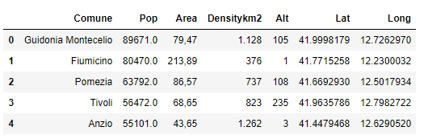
Method Part 3
Next, we order the towns in order of descending population size and selected the top 5 towns. The result is as shown below.

Slide 10
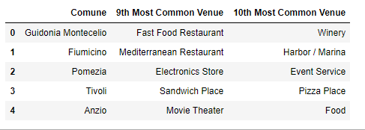
Results
We select the second and last least common venue in each of the towns to propose are a potential business to start. This yield the table below as result.
The proposal would therefore be to start a Fast Food restaurant or a winery in the town of Guidonia Montecelio.

Slide 11
Discussion
For the town Anzio the model suggest a Movie theatre as one option, which is viable. The second option is too vague to be useful.
The data retrieved from Foursquare is not very consistent about types of venues. For instance, Mediterranean Restaurant and Italian restaurant are different categories.
It also includes things like “scenic lookout” that is not a business and categories like “food” which is too general.
For a further refinement of this project, I would recategorize some of the venues to get more consistent groupings.
I might also consider getting more detailed information regarding the population age distribution in each town to pick a town with the highest number of economically active residents.

Slide 12
